Slide 1


Turning insurance data into actionable insights through interactive Power BI dashboards.
Presented By Harsha Sharma

Slide 2
Topics
About Company
Problem Statement
Project Objective
Dataset Overview
Key Terms
Dashboard View
Insights
Recommendations

Slide 3
About Company
Shield Insurance provides affordable & customizable insurance solutions tailored to individuals across all age groups.
With a presence in Mumbai, Chennai, Delhi, Hyderabad, Indore.
The company operates through offline agents, direct sales teams, a mobile app, and a website.

Slide 4
Problem Statement
Shield Insurance currently lacks a consolidated & interactive view to effectively monitor customer growth, revenue performance, policy trends.
Additionally, there is limited visibility into how customer behaviour varies across age groups, cities, sales modes, and policies.
This makes it difficult for stakeholders to identify growth trends, evaluate sales channel performance & understand demographic impacts on revenue and settlement expectations.

Slide 5
Project Overview
Track total customers & total revenue
Monitor daily & month-over-month growth trends
Analyze performance across cities, sales modes, policies, age groups
Identify high-value customer segments & effective sales channels
Understand age-group-wise revenue contribution & expected settlement exposure

Slide 6
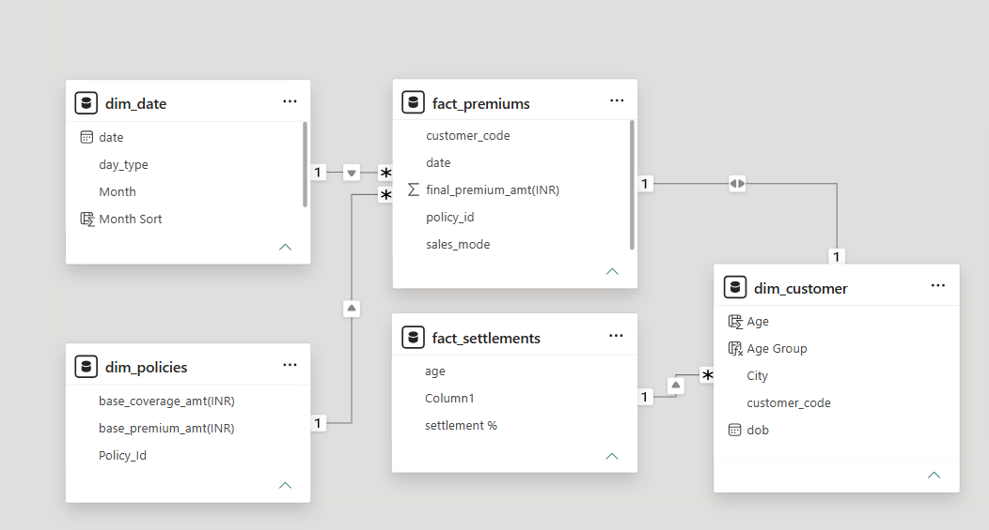
Dataset Overview

Slide 7
Key Terms
Base Coverage Amount — The maximum amount the insurance policy covers in case of a claim.
Premium — The amount paid by the customer to keep the insurance policy active.
Claim — A request made by the customer to receive financial coverage for a covered loss.
Settlement Amount — The amount actually paid by the insurer to settle an approved claim.
Settlement Percentage — The percentage of the claim amount that has been settled/paid by the insurer.

Slide 8
Dashboard View

Slide 9
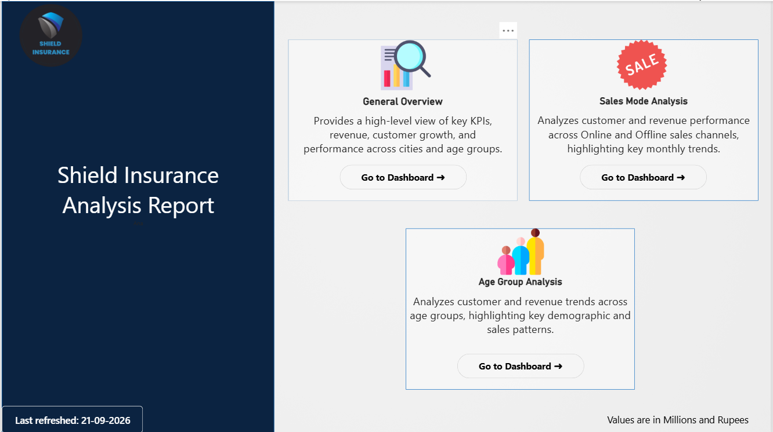
Home Page

Slide 10
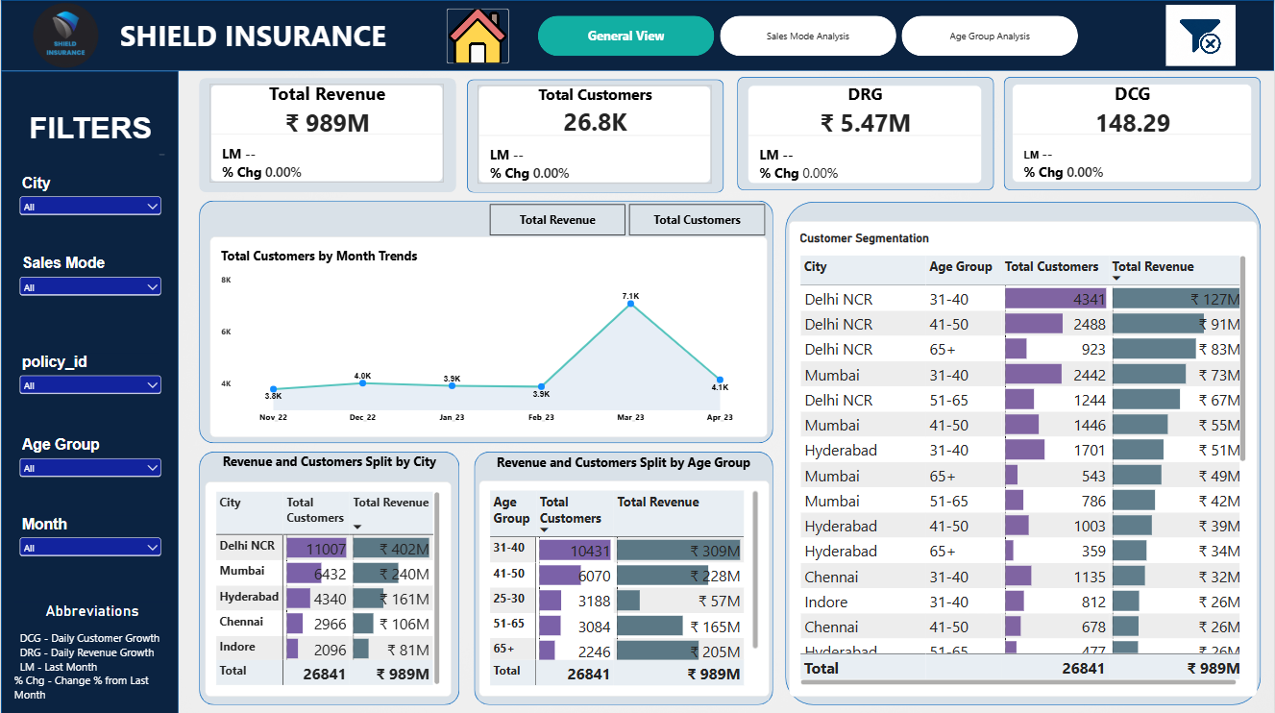
General Overview

Slide 11
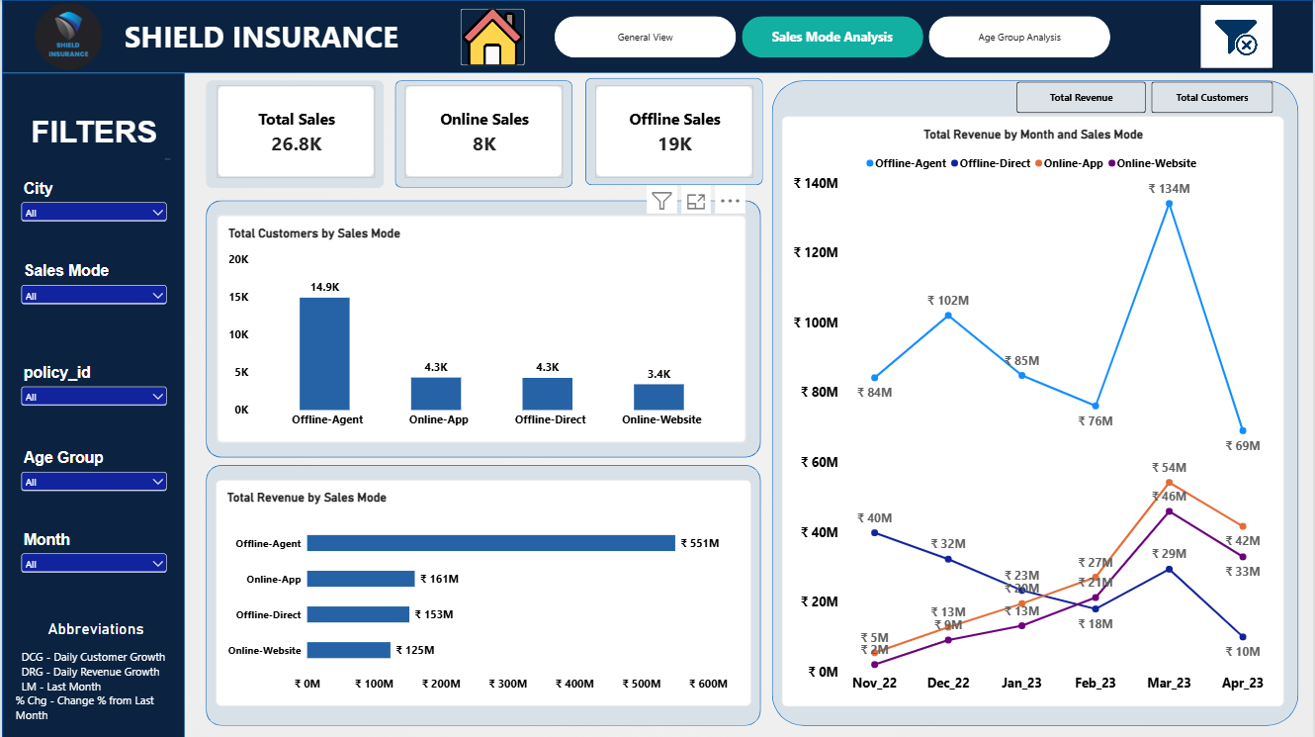
Sales Mode Analysis

Slide 12
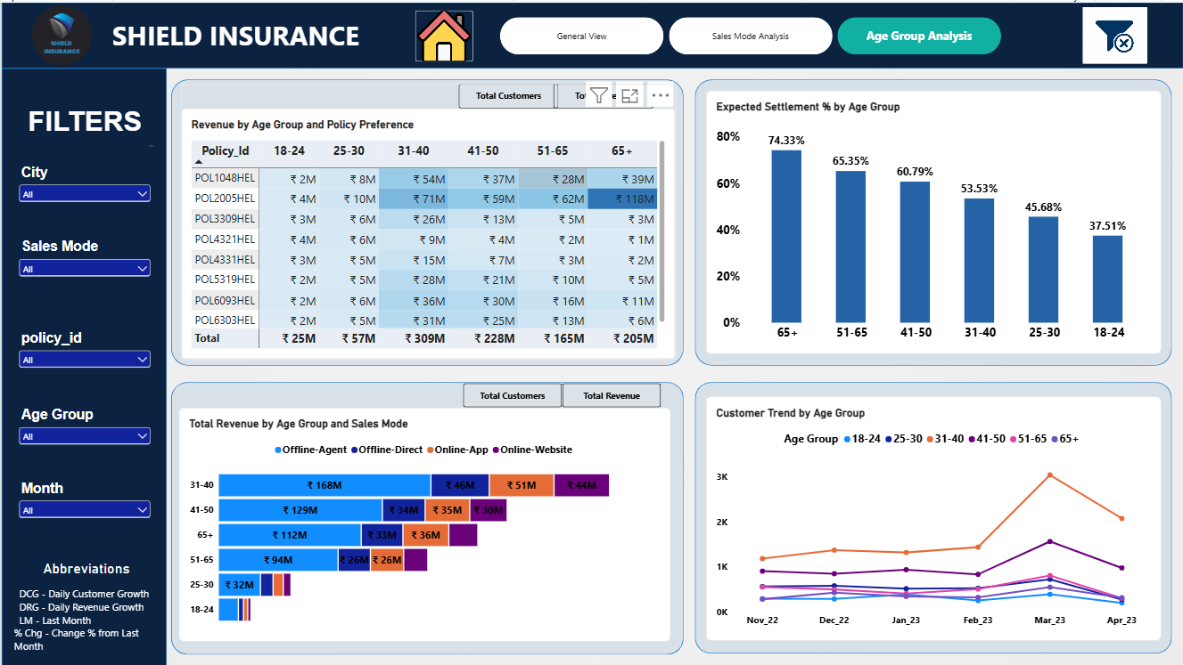
Age Group Analysis

Slide 13
General View - Insights
Overall Performance: Total revenue ₹989M generated from 26.8K customers, with ₹5.47M DRG and 148.29 DCG.
Delhi NCR: Highest revenue ₹402M | Highest customers 11,007
Indore: Lowest revenue ₹81M | Lowest customers 2,096
Mumbai: Second-highest revenue ₹240M | 6,432 customers
31–40 Age Group: Highest revenue ₹309M | Highest customers 10,431
March: Peak month — Revenue ₹264M | Customers 7,081
November: Weakest month — Revenue ₹132M | Customers 3,787

Slide 14
Sales Mode Analysis - Insights
Offline Agent: Dominates customers 14,873 (55.41%) | Revenue ₹551M (55.67%)
Online App: 4,302 customers (16.00%) | Revenue ₹161M (16.28%)
Offline Direct: 4,256 customers (15.9%) | Revenue ₹153M (15.47%)
Online Website: Lowest customers 3,410 (12.70%) | Revenue ₹125M (12.64%)
March: Peak month across sales modes, with Offline Agent reaching 3.5K customers and ₹134M revenue.
November–April Trend: All sales modes show their strongest performance in March, followed by a decline in April.

Slide 15
Age Group Analysis
• 31–40: Highest revenue ₹309.32M | Highest customers 10,431
• 41+ Age Groups: Strong customer base of 11,400 | Revenue of approximately ₹598M
• Under 30 (18–24 & 25–30): Lowest revenue — ₹25M and ₹57M respectively
• Settlement %: Increases consistently with age — from 37.51% (18–24) to 74.33% (65+)
• POL2005HEL: Highest overall revenue contribution, driven particularly by the 65+ segment with ₹118M

Slide 16
Recommendations
Prioritize Core Segments: Focus on the 31–40 and 50+ age groups to support revenue, retention, and settlement performance.
Address Underperforming Segments: Investigate the under-30 age groups and lower-performing cities such as Indore for growth opportunities.
Strengthen Digital Adoption: Maintain the strong Offline Agent channel while improving the Online Website experience and adoption.
Optimize Product Portfolio: Expand the reach of POL2005HEL and evaluate the revenue contribution of policies with high customer volumes but lower revenue.
Replicate City Best Practices: Study the Delhi NCR sales pattern and identify practices that could be applied to other cities.
Leverage Seasonal Trends: Use the strong March performance pattern to design campaigns that can improve weaker months such as November.

Slide 17


